Slide 1
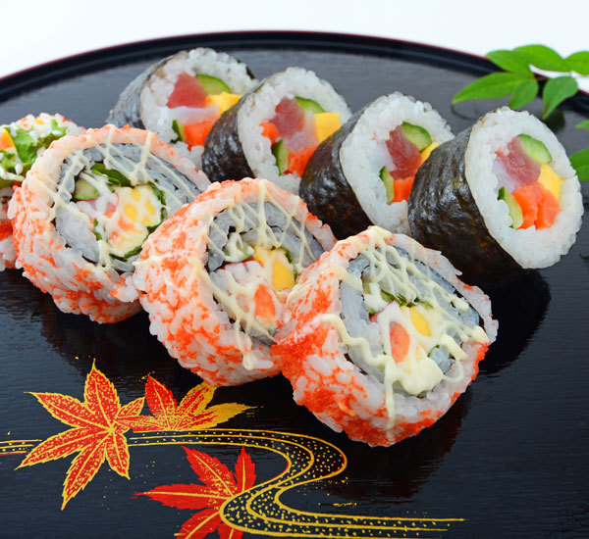
Using CLUSTERING TO FIND A “SUSHI TRAIL”

Slide 2
Business UNDERSTANDING/INTRODUCTION
I am an avid traveller and visited Vancouver, BC, Canada.
In Vancouver, I created a list which consisted of Asian restaurants which served different kinds of sushi.
I called the list the “Sushi Trail” as an homage to the various hiking trails in Vancouver.
The only rule of the “Sushi Trail” is that you have to go to every restaurant back to back and eat a different type of sushi in each restaurant.
I plan on visiting New York City and staying there for 5 days.
I want to create a similar Trail for NYC, however, the number of Asian Restaurants is very high in comparison to Vancouver.
A potential Trail would consist of a good number of restaurants which are all spaced at similar small distances from each other.
The final trail can be chosen from a pool of potential trails depending on accommodations, proximity e.t.c

Slide 3
Methodology
Follows methodology used in Ungraded Lab 3.
Data processing is done in pandas after downloading the neighbourhood dataset from a free online source[1].
Using Foursquare API, the data can be used as an input in order to explore each neighbourhood.
Restricted Neighbourhood to Manhattan dues to proximity and accommodation restrictions.
Used k means clustering and folium to cluster and depict restaurants in NYC’s 5 boroughs.
[1] https://geo.nyu.edu/catalog/nyu_2451_34572.

Slide 4
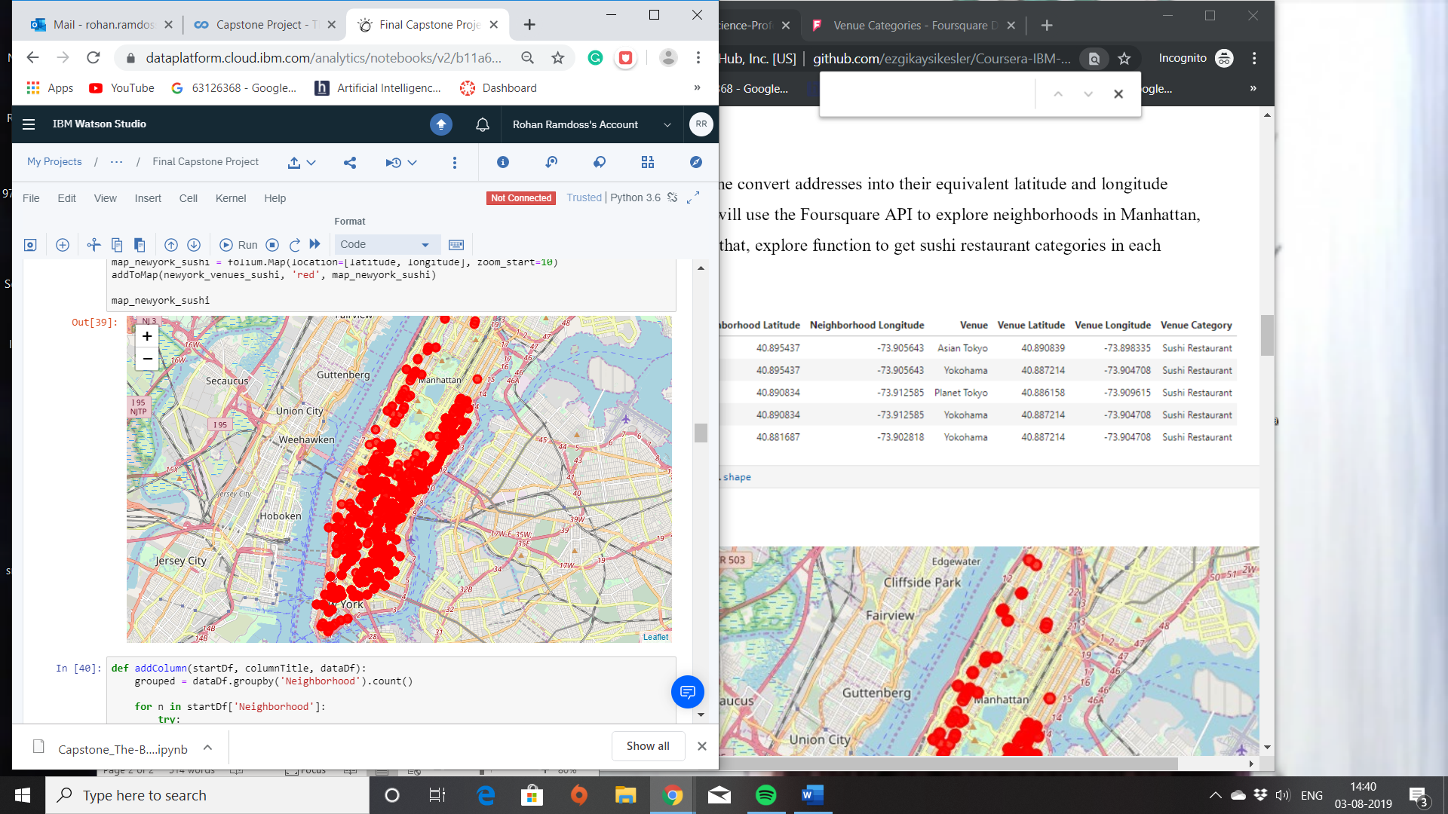
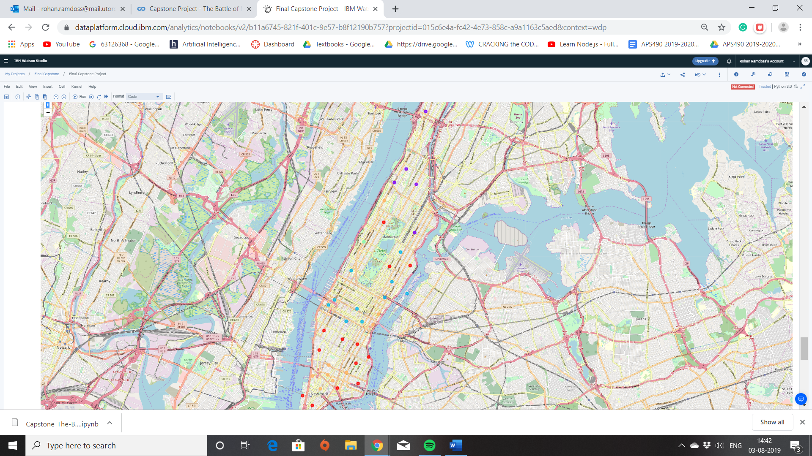
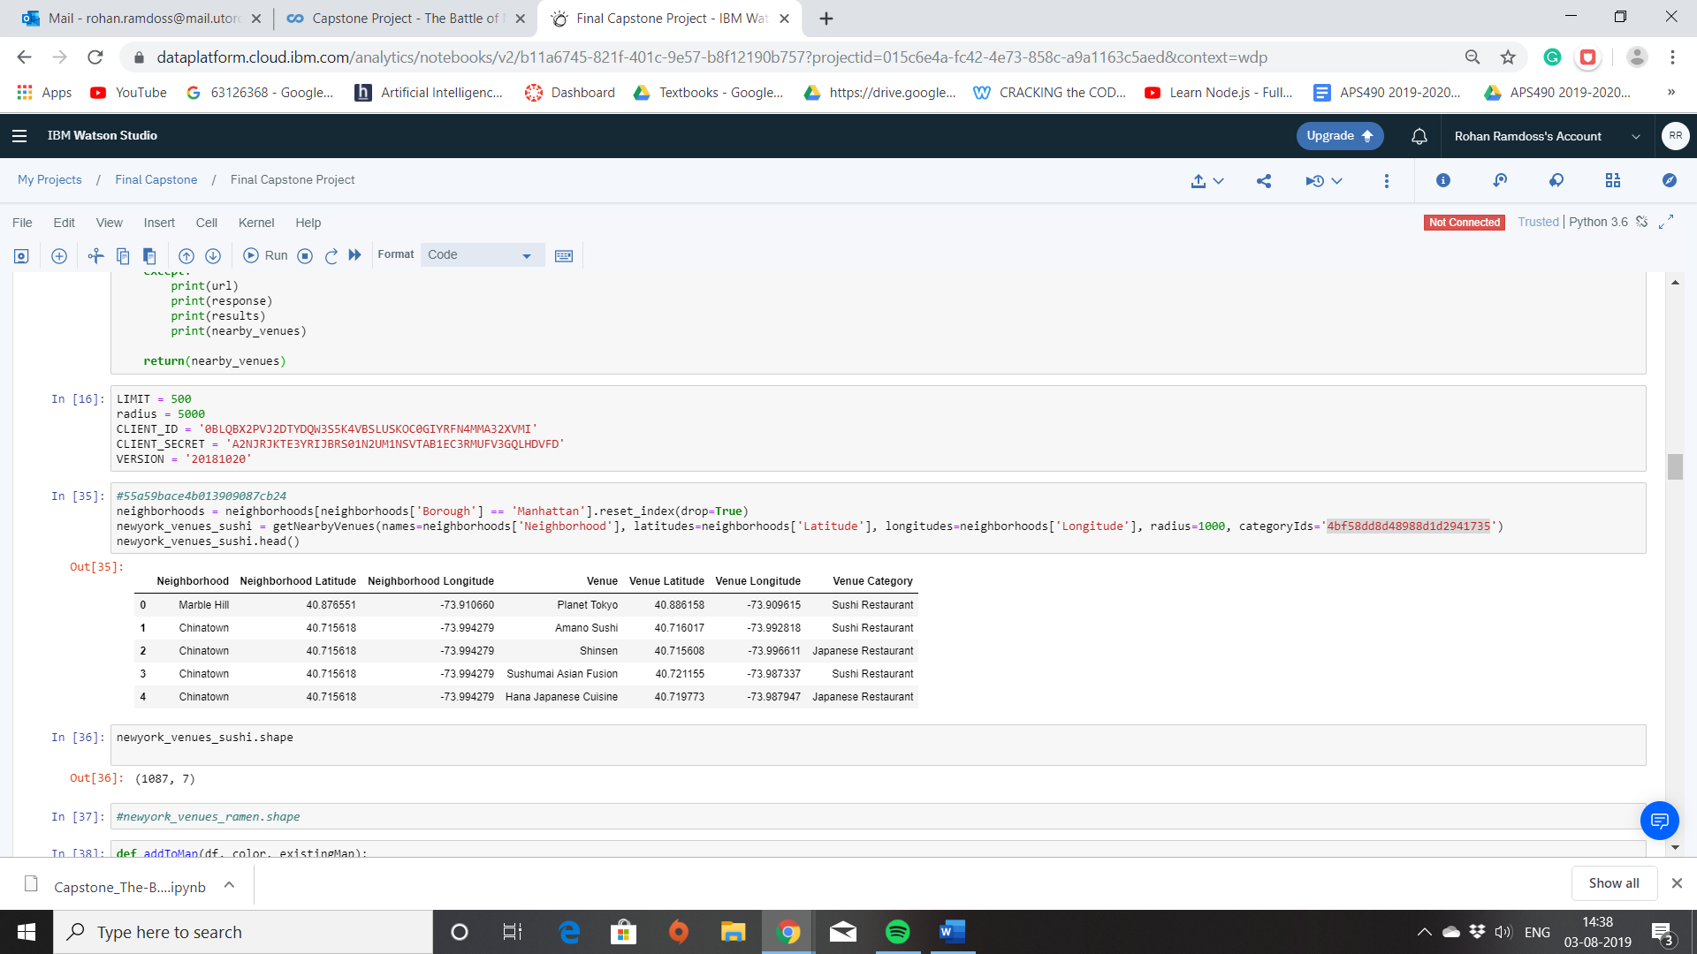
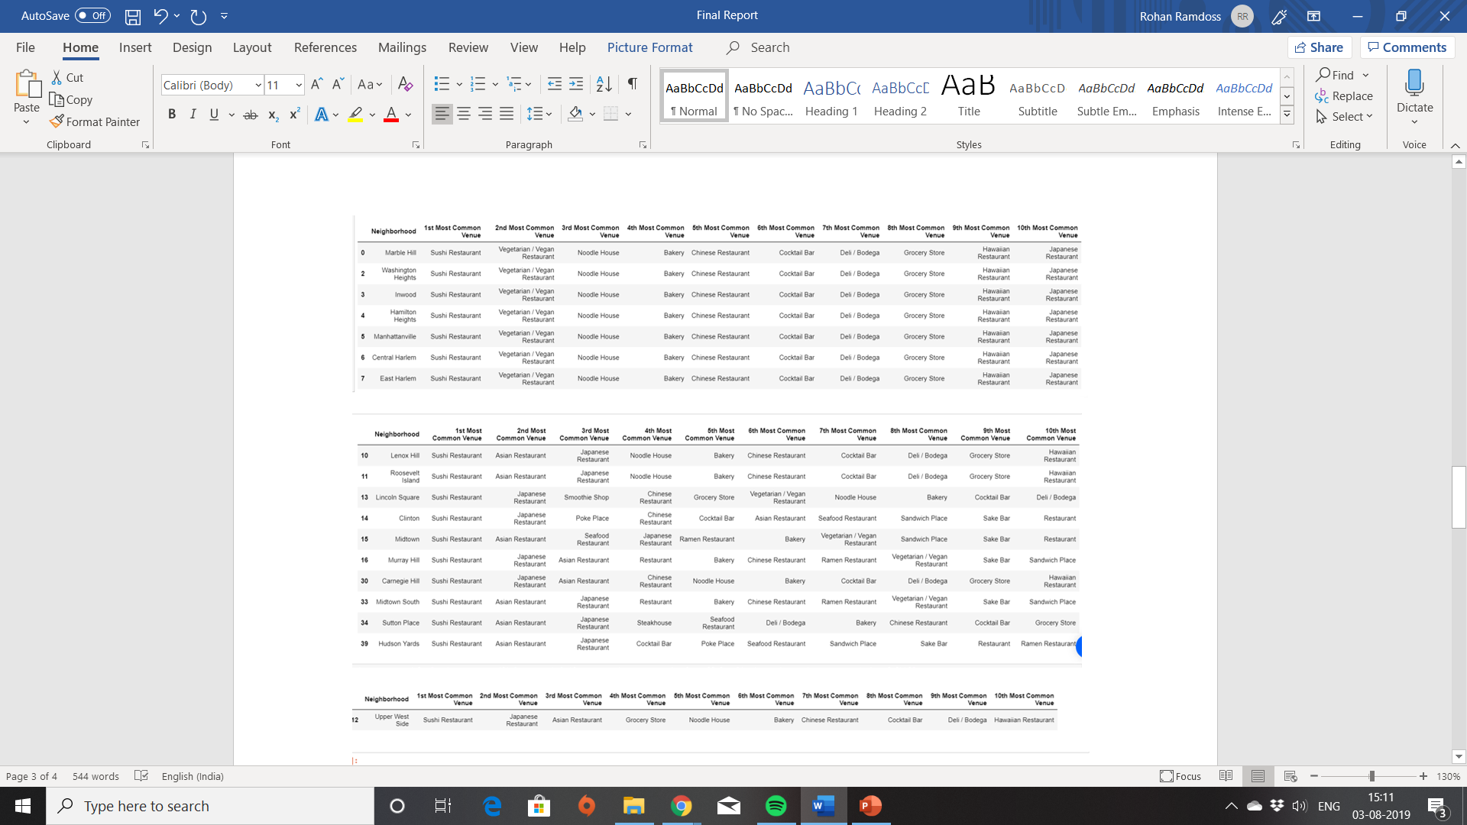
Results - Raw Representations vs Clusters - Raw Data vs Clustered Data

Slide 5
Interpretation AND ConcLUSION
There were 3 clusters of the similar sizes.
The final cluster had a good balance of number of restaurants and distance between them.
The final cluster was found to be in east village and lower Manhattan.
The final cluster consisted of 13 restaurants with one outlier which can be discarded.

